Slide 1
Our community
Cuizauca

Slide 2
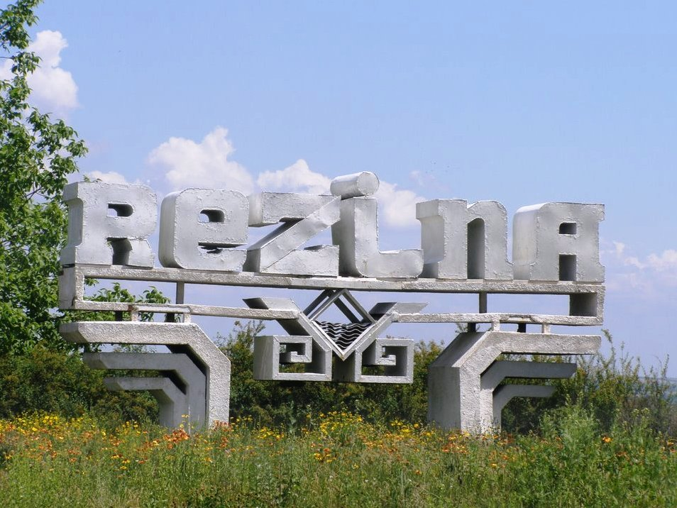
Nearest city is REZINA,with dimensions of 33,52 km2

Slide 3
Location of our community in the south of Rezina

Slide 4
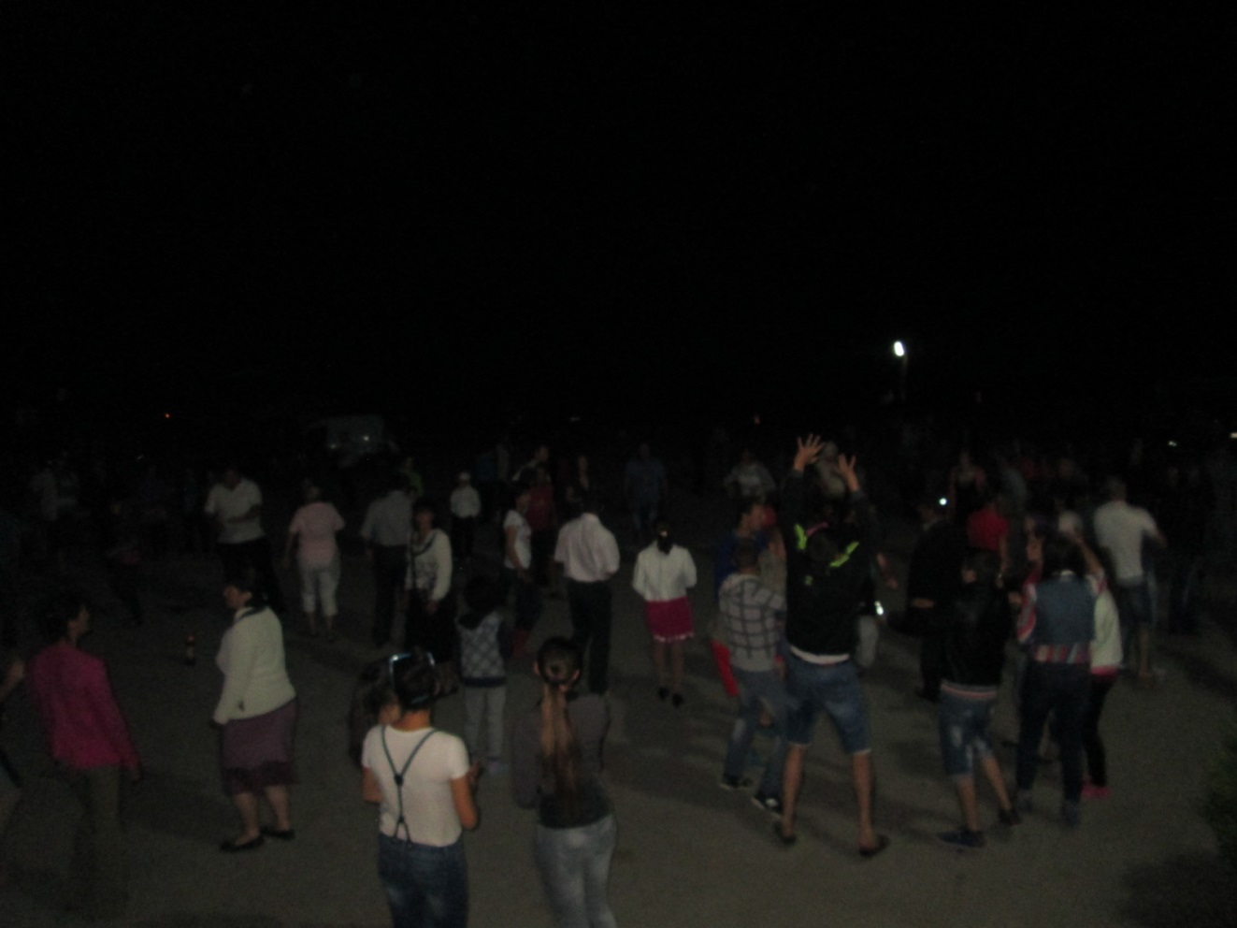
The population of our community
The population consists of 1437 people .

Slide 5
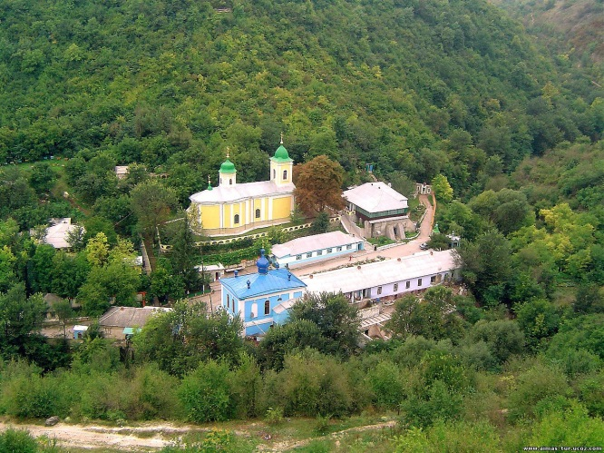
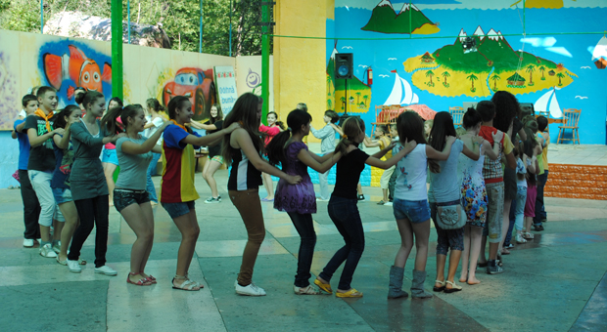
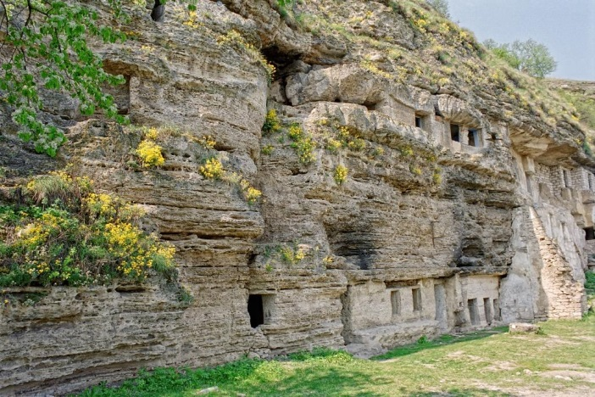
Special characteristics: 3 reasons why people come to visit our area are:
1.Near the monastery Cuizauca 2.We have natural complexes Saharna and Tipova. 3.Rest camp “Nistru”

Slide 6
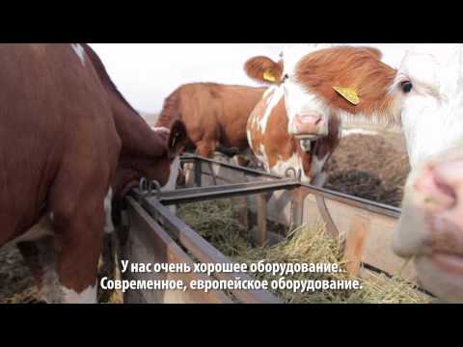
Occupation
Occupation in our community is represented by brothers’ Luchian farm.

Slide 7
Other information
Living permanently in this "breath of heaven" Cuizaucenii (so the population is called) turned it through hard work into one of the most prosperous places in this area. Local geographical underground resources, climatic conditions created ground for the various types of activities: agriculture and grazing, hunting and fishing.

Slide 8
We love Cuizăuca

